Slide 1

Web fundamentals project
Taher KHADHRAOUI

Slide 2
Q1. How does the web work ?
The USER enters a URL into a web browser
The browser looks up the IP address for the domain name via DNS
The browser sends a HTTP request to the server
The server sends back a HTTP response
The browser begins rendering the HTML
The browser sends requests for additional objects embedded in HTML.
Once the page is loaded, the browser sends further async requests as needed.

Slide 3
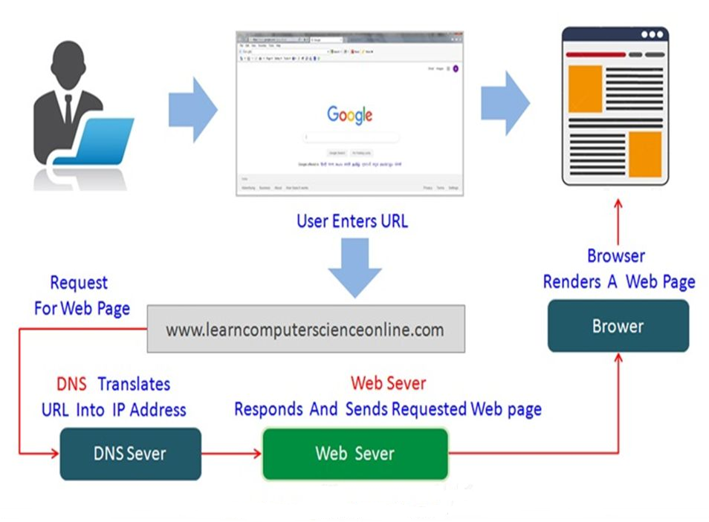
Q1. How does the web work ?

Slide 4
Q2. What do you need to be a web developer ?
Learn web development fundamentals, including an understanding of HTML, CSS and JavaScript.
Choose a development specialization. All Web Developers are categorized into three main types:
Front-End Developer.
Back-End Developer.
Full-Stack Developer.
Learn key programming languages for web development
Work on projects to develop your Web Developer skills
Build a web development portfolio

Slide 5
Q3. What is the role of a web developer ?
A Web Developer should cover:
Create website layout/user interface by using standard HTML/CSS practices
Write well designed, testable, efficient code by using best development practices
Integrate data from various back-end services and databases
Implementing contingency plans in case the website goes down
Maintaining and expanding/enhancing the website once built

Slide 6
Thank you for your attention

